Slide 1
CAP615 PROGRAMMING IN JAVA
Presented by
Kumar Vishal

Slide 2
Basic java concepts
Java keywords,
variables,
data types,
operators and
control statements

Slide 3
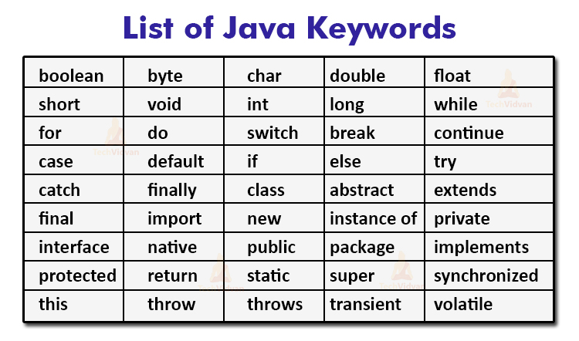
Java keywords: reserve words

Slide 4
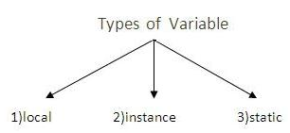
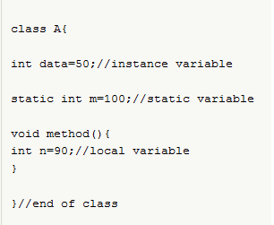
Variables

Slide 5
Data types in Java
Primitive
Non primitive
boolean
byte
short
int
long
char
float
double
String
Array
Class
Interface

Slide 6
Wrapper class
Some time we need to convert primitive into object and object into primitive.
There are different scenarios, where we need to use the wrapper classes.
For example In case of Serialization: We need to convert the objects into streams to perform the serialization. If we have a primitive value, we can convert it in objects through the wrapper classes.
Like in collection framework works with objects only. All classes of the collection framework (ArrayList, LinkedList, Vector, HashSet, LinkedHashSet, TreeSet, PriorityQueue, ArrayDeque, etc.) deal with objects only.

Slide 7
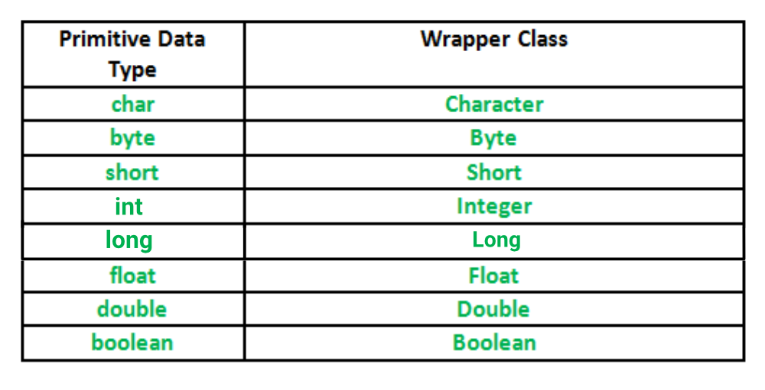
A Wrapper class is a class whose object wraps or contains
primitive data types.

Slide 8
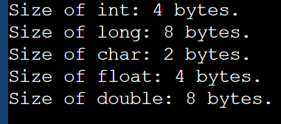
To find size of datatypes
class MainClass
{
public static void main(String []args)
{
System.out.println("Size of int: " + (Integer.SIZE/8) + " bytes.");
System.out.println("Size of long: " + (Long.SIZE/8) + " bytes.");
System.out.println("Size of char: " + (Character.SIZE/8) + " bytes.");
System.out.println("Size of float: " + (Float.SIZE/8) + " bytes.");
System.out.println("Size of double: " + (Double.SIZE/8) + " bytes.");
}
}

Slide 9
autoboxing and unboxing
Important :what is autoboxing and unboxing?
The wrapper class in Java provides the mechanism to convert primitive into object and object into primitive.
The automatic conversion of primitive into an object is known as autoboxing and vice-versa unboxing.

Slide 10
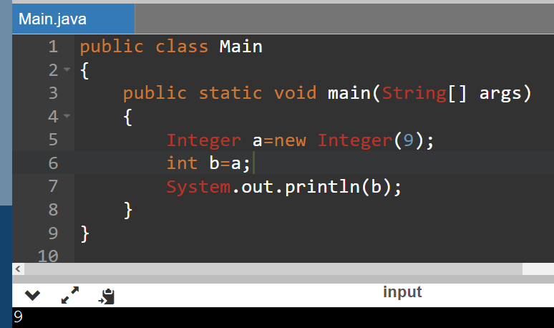

Slide 11

Operators

Slide 12
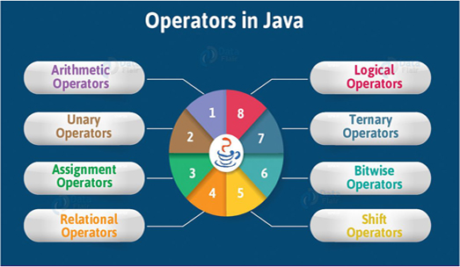

Slide 13
Arithmetic operators
Operator | Name | Example
+ | Addition | x + y
- | Subtraction | x - y
* | Multiplication | x * y
/ | Division | x / y
% | Modulus | x % y

Slide 14
Assignment Operators
Operator | Example | Same As
= | x = 5 | x = 5
+= | x += 3 | x = x + 3
-= | x -= 3 | x = x - 3
*= | x *= 3 | x = x * 3
/= | x /= 3 | x = x / 3
%= | x %= 3 | x = x % 3
&= | x &= 3 | x = x & 3
|= | x |= 3 | x = x | 3
^= | x ^= 3 | x = x ^ 3
>>= | x >>= 3 | x = x >> 3
<<= | x <<= 3 | x = x << 3

Slide 15
Comparison operators
Operator | Name | Example
== | Equal to | x == y
!= | Not equal | x != y
> | Greater than | x > y
< | Less than | x < y
>= | Greater than or equal to | x >= y
<= | Less than or equal to | x <= y

Slide 16
Logical operators
Operator | Name | Description | Example
&& | Logical and | Returns true if both statements are true | x < 5 && x < 10
|| | Logical or | Returns true if one of the statements is true | x < 5 || x < 4
! | Logical not | Reverse the result, returns false if the result is true | !(x < 5 && x < 10)

Slide 17
Bitwise operators
Operator | Description
& | AND Operator
| | OR Operator
^ | XOR Operator
~ | Ones Complement Operator
<< | Left Shift Operator
>> | Right Shift Operator

Slide 18
Unary Operators in Java
Java unary operators are the types that need only one operand to perform any operation like increment, decrement, negation, etc. It consists of various arithmetic, logical and other operators that operate on a single operand.

Slide 19
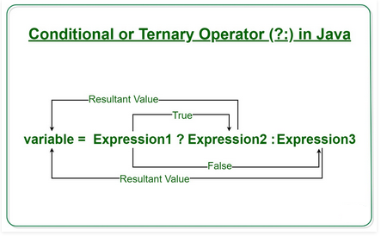
Ternary Operator
Java ternary operator is the only conditional operator that takes three operands. It’s a one-liner replacement for if-then-else statement and used a lot in Java programming.

Slide 20
Control Statements:
if/else constructs
switch statement
looping controls, nested loops

Slide 21
if/else constructs
If(condition)
{
// statement execute when condition true
}
else
{
// statement execute when condition false
}

Slide 22
switch statement
To select choices/options from user it used:
Switch with choice (integer value like: 1,2,..)
Switch with choice (character value like: A,B,..)
Switch with choice (String value like: “ADD”,”SUB”,..)

Slide 23
looping controls, nested loops
While loop
Do while loop
For loop
Enhanced or advanced for loop
Nested loops means one loop inside another loop.

Slide 24
Enhanced For loop
for(data_type variable : array | collection)
{
//body of for-each loop
}

Slide 25
Example:
int myArray[]=new int[]{11,12,13,14,15};
for(int num : myArray)
{
System.out.println(num);
}

Slide 26
Any Query??

